Slide 1
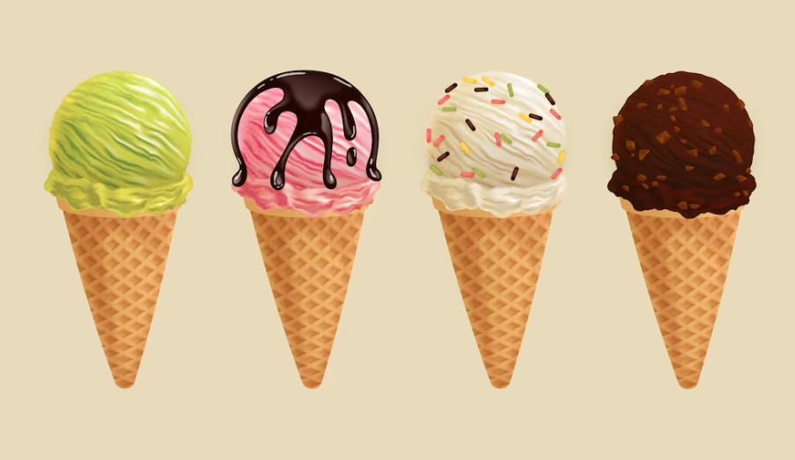

Slide 2
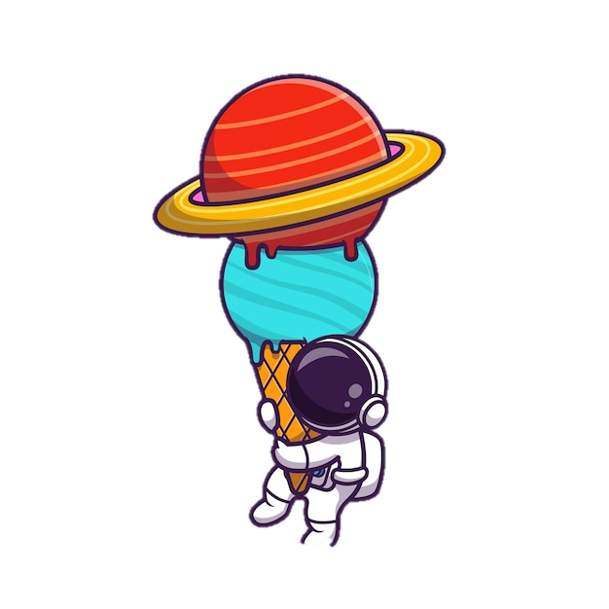


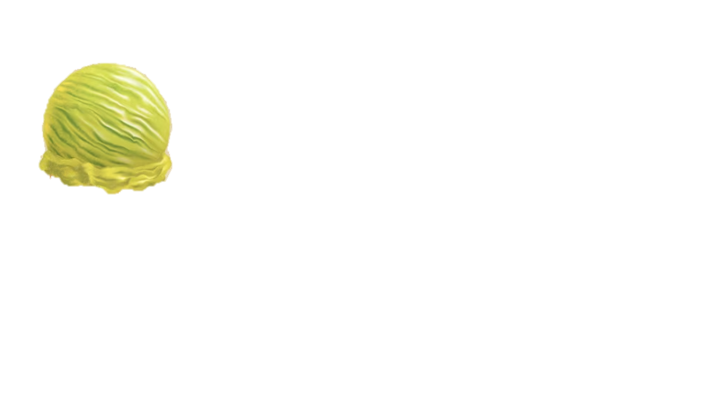
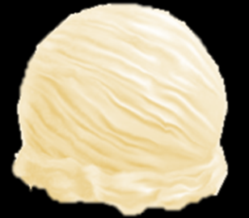


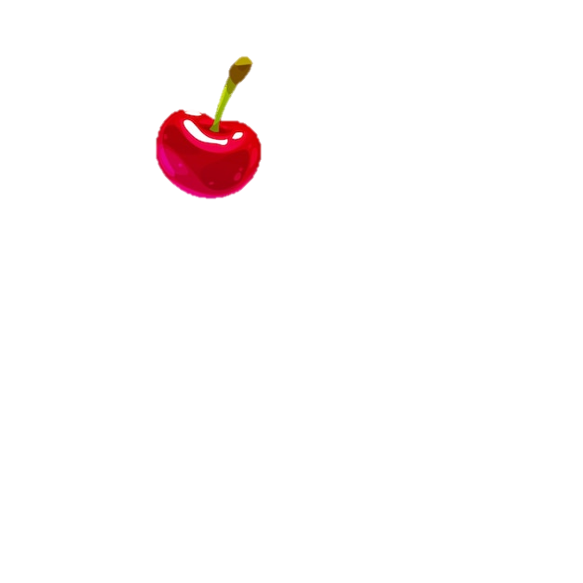

Special Items
How to play
Use left and right arrows to move the ice cream cone
Slow Time
The next 10 items will be sloooooow
Complete the order by catching the corresponding balls
Anti Gravity Feather
Be light like a feather for 10 seconds and retrieve your speed!
End your ice cream by adding a cherry on top ☺

Slide 3


Slide 5


Slide 6


Slide 7



Slide 8


Slide 10



Slide 12



Slide 15
Hello world
Icecream orders
NEXT
RETRY
1 2 3 36

Slide 16



Slide 17


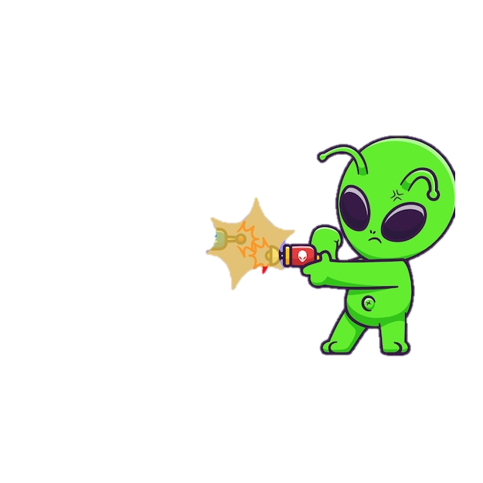
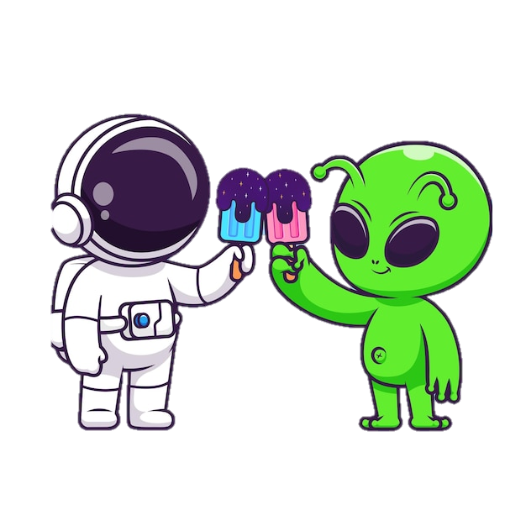
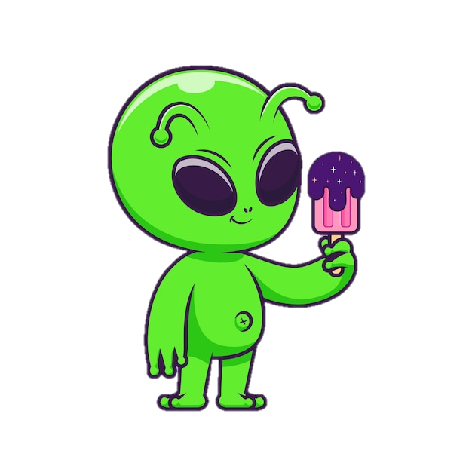

Slide 18
CONGRATULATIONS

Slide 19


YOU FAILED!

Slide 20
THANK YOU FOR PLAYING GALATIC ICE CREAMS

Slide 21

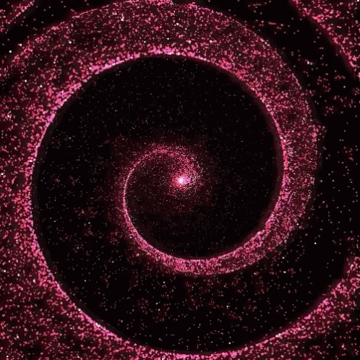

Slide 23
